Slide 1
Daniel Defoe
Defoe: dissenter, businessman, “projector,” journalist, political agent, satirist, novelist

Slide 2
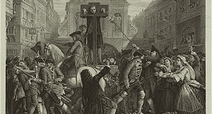
A signature moment: Defoe in the Stocks

Slide 3
What is the status of “wandering” in RC?
In other material you have read?
Wandering
Error
“rambling thoughts” (47)
“leaving my father’s house” (47)
“repenting Prodigal” (52)
  See also p. 75.
  A father’s advice (47-50): “the middle State” or “the upper Station of Low Life”

Slide 4
But wandering GENERATES THE FICTION and sets the stage for the development of a self.
  Which ought a son to do: go to sea or comply with the father’s direction?
  CLAIM: The explicit moral warnings work against the creation of fiction. If the son stays home and follows all the rules . . . .
    Let’s complicate the question with Marx’s suggestion—that RC soon begins to behave like a “true-born Briton” (383).

Slide 5
Close analysis
  But if I can express at this distance . . . (55)
  Dead heart and horror of mind . . . (56)
  Prodigal son (57); Jonah (57-8)
  Remembrance wore off 59
  Aspiration & ruin (60)
  He sets up for a “Guiney trader” (60)
  From merchant to slave (61); Master (61)
  Deliverance (63) Contrivance (64)
  “Nations of Negroes” (65)

Slide 6
Survival & the State of Nature
  The Moor (65)
  Particulars: “a good charge of Powder, and with two slugs” (69)
  Survival alone (85)

